Slide 1
Training Nurses in Multidisciplinary Settings
Glenda Whiting
Principal Lecturer – Health
TAFESA
Adelaide South Australia

Slide 2
Multidisciplinary care occurs when professionals from a range of disciplines with different but complementary skills, knowledge and experience work together to deliver comprehensive healthcare aimed at providing the best possible outcome for the physical and psychosocial needs of a patient and their carers.

Slide 3
Multidisciplinary teams convey many benefits to both the patients and the health professionals working on the team.
These include improved health outcomes and enhanced satisfaction for clients, and the more efficient use of resources and enhanced job satisfaction for team members.

Slide 4
Australian College of Nursing
Demand for health care is exceeding supply
the population and health workforce ages
consumer expectations heighten.
nowhere is this gap more apparent than in the health systems capacity to deliver acute services.
more integrated primary care models of care will need to replace the traditional acute model of care
Already significant reform has taken place to achieve this, including increases to day procedures, ambulatory care, hospital in the home, tele-health and nurse led clinics.
The way health care is delivered and by whom critically needs to be reconsidered. The traditional roles of health professionals, and professional boundaries that constrain workforce capacity and flexibility, need to be challenged, including reforms to ensure that all health professionals work to their full scope of practice (HWA, 2014).

Slide 5
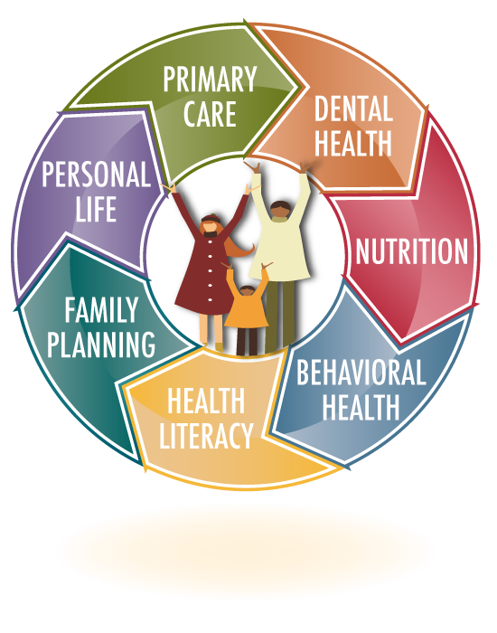
Primary health care – an example
Primary health care is based on a model of collaborative transdisciplinary care as opposed to being led by any one professional group.
managing the continuum through health promotion;
prevention of illness
and illness to health involves a range of health professionals and other workers
safety and quality for individuals and the community
prevention or intervention strategy is always
Notes:
Primary health care is based on a model of
collaborative transdisciplinary care as opposed
to being led by any one professional group. In
a model of transdisciplinary care, managing the
continuum through health promotion; prevention
of illness; and illness to health involves a range
of health professionals and other workers. The
safety and quality for individuals and the community
of any primary health promotion, prevention or
intervention strategy is always an essential
consideration.
Collaboration between colleagues who are
clinicians in active practice, researchers, policy
makers and educators enable the teams to
maintain their capacity to innovate and improve
practice for the benefit of the community

Slide 6
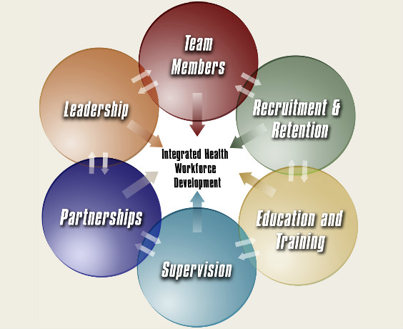
Education
All health care workers are suitably educated socially, professionally and technically to work as a part of a health care team and to respond to the expressed health needs of the community.

Slide 7
Education
Effective transdisciplinary health care requires pre-entry and ongoing integrated interprofessional development and education.
a cooperative and collaborative approach to practice between nursing and midwifery students, medical students and students of other health professions is present right from the beginning and throughout their careers
Notes:
This is achieved by the incorporation of transdisciplinary education into the curricula of all the health professions, so a cooperative and collaborative approach to primary health care practice between nursing and midwifery students, medical students and students of other health professions is present right from the beginning and throughout their careers.

Slide 8
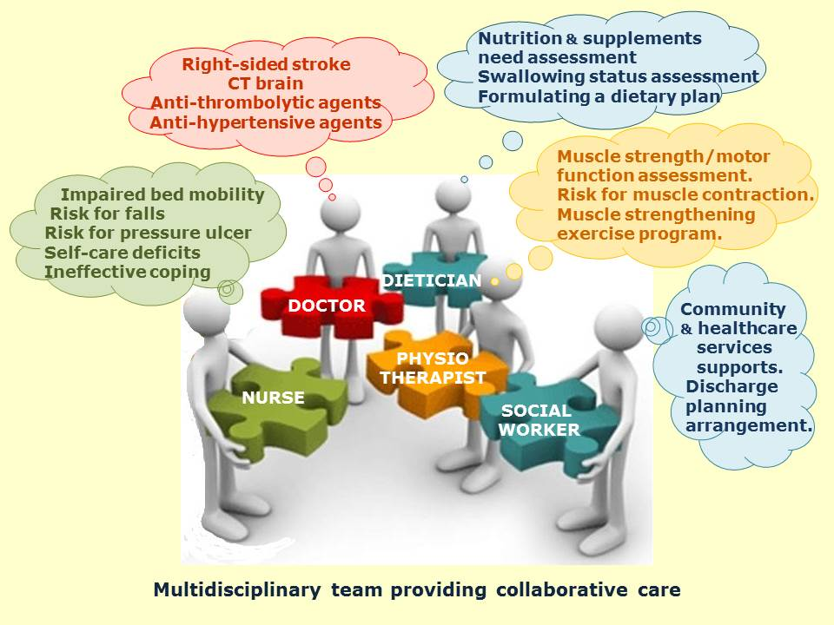
Education
The development of integrated undergraduate, postgraduate, and clinical education curricula assists in the promotion and extension of inter-professional recognition, understanding
and cooperation.

Slide 9
Problems
The current systems for health funding in Australia create serious barriers to effective health promotion and chronic disease management, and limit effectiveness in terms of equity, access and value for money.
The models of promotion, prevention, care and treatment are not always based on the best available evidence

Slide 10
Problems
The current modalities do not necessarily provide positive outcomes for people and their communities; and sustainable, replicable service delivery remains a challenge
Funding models for good health should support sound health policy designed to meet population needs

Slide 11
Solutions
To encourage a primary health care focus within education and training programs a broad perspective on health and health service delivery is critical
Future teaching models with integration
of educational programs around chronic illnesses, communication strategies and lifestyle changes must have high priority and should aim at a transdisciplinary audience

Slide 12
Solutions
The teaching model needs to be a shared academic and clinical model, that is current expert practitioners should be invited to teach in academic courses to provide a rich contemporary experience to students.
A shared teaching model will also enable academic staff to make links between research and practice and assist the implementation of evidence-based practice.
The shared model will also assist in overcoming the current problem of shortage in clinical mentorship.

Slide 13
Solutions
Supporting education in a sustainable way
The role of education can be supported by the creation of part-time academic-clinical teaching positions.
Moreover, ongoing financial and professional support to courses and other professional activities are integral parts of maintaining individual's motivation, providing opportunities to develop skills and knowledge to cope in a changing environment

Slide 14
Solutions
Transdisciplinary learning needs to be a full part of the educational socialisation so that different professions are able to relate to each other and gain a thorough understanding of each profession's expertise and competencies within primary health care settings.
Transdisciplinary education programs at both horizontal and vertical levels are essential to achieve this.

Slide 15
Solutions
clinical placements organised so the different student groups work together, for example having mixes of nursing, midwifery, allied health and medical students go into clinical placements together.
students work around case studies together learning how and when to refer and to communicate with the full health care team, including nurses, midwives medical practitioners, physiotherapists, occupational therapists, health psychologists etc).
Notes:
It is therefore of critical importance that clinical placements are organised so the different student groups work together, for example having mixes of nursing, midwifery, allied health and medical students go into clinical placements together.
These students could work around case studies together learning how and when to refer and to communicate with the full health care team, including nurses, midwives medical practitioners, physiotherapists, occupational therapists, health psychologists etc).

Slide 16
Solutions
Problem-based learning
Experiential teaching approaches that encourage problem solving and evaluation of health outcomes for the individual person, their families and in some cases the whole community are important.
The principles problem based learning
build on developing inquiry and decision-making skills;
collaboration in learning tasks;
the development of autonomous learning;
contextualisation of problem foci to the practice domain and
the encouragement of a thirst for knowledge.

Slide 17
Solutions
Clinical mentoring
It is critical that the clinical component of the teaching program includes a high level of mentoring.
A combination of academic and clinical teaching staff would
assist to ensure the transition from universities to clinical environments be as smooth as possible for the students.
A smoother transition between the two systems might have a flow on effect in retaining graduates in the particular health care setting.

Slide 18
Solutions
A combined multidisciplinary academic and clinical
teaching and learning model creates an excellent
foundational model to promote competency based
education.

Slide 19
The result
Transdisciplinary interactions in the working environment encourage team work and assist in achieving the common purpose of producing better health outcomes. Good health outcomes for people give confidence and professional
satisfaction, which is motivating to health professionals.

Slide 20
glenda.whiting@tafesa.edu.au
CRICOS Code: 00092B | RTO Code: 41026 | HEP Code: PRV14002 | Accurate as December 2017

